Slide 1

Big Mountain Resort: Data-Driven Pricing Strategy
Optimizing Ticket Prices and Investments for Sustainable Growth
Mesfin Kebede

Slide 2
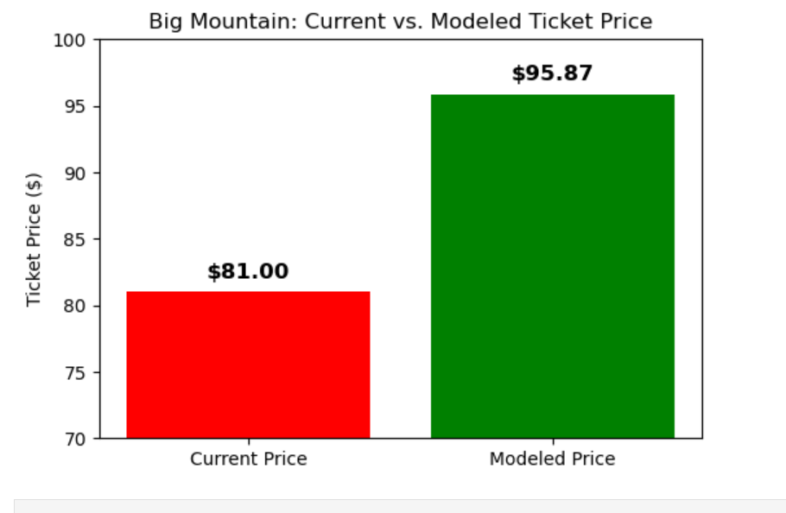
The Problem – Lost Revenue Due to Underpricing
Big Mountain is Leaving Money on the Table
Current ticket price: $81
Market-supported price: $95.87
Lost revenue opportunity
Why it matters: Revenue potential is being missed.
🔹 How can we capture this untapped value without losing customers?
Notes:
Notes: “Hi everyone. Let's start with a question—are we truly making the most of our pricing potential? Big Mountain Resort is a premium skiing destination, but are we charging what the market supports? Right now, our weekend ticket price is set at $81, but based on our model, the market can support a price of $95.87. That’s a revenue gap we can’t ignore. This chart shows how our current pricing compares to the modeled optimal price. The key question is: how can we capture this untapped value without losing customers?"
Notes: Start with a compelling question like "Are we making the most of our pricing potential?" This will hook the audience and lead them into the data.

Slide 3
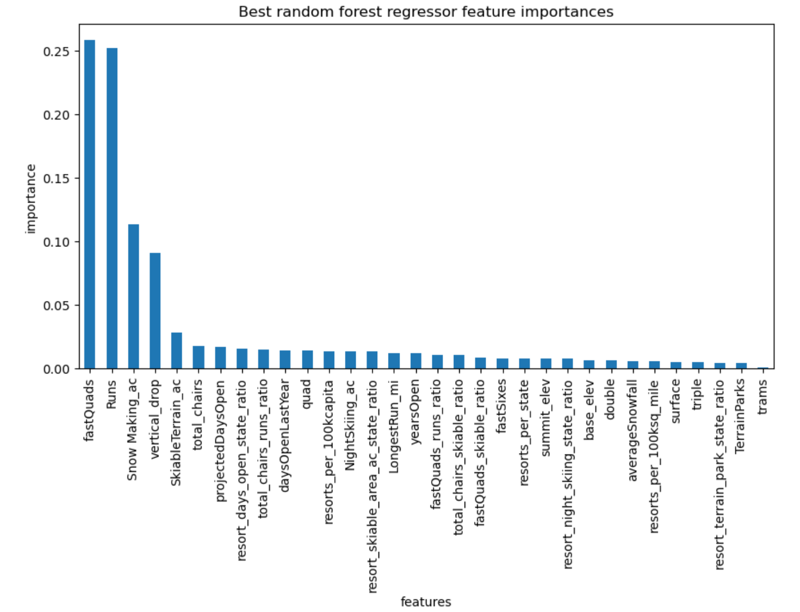
What Drives Ticket Prices?
Some Resort Features Drive Pricing More Than Others
Top 4 Pricing Factors:
Fast Quads 🚠
Number of Runs 🏔
Vertical Drop 📉
Annual Snowfall ❄️
🔹 Investing in the right areas will increase pricing power.
Notes:
Notes: "Now, let’s talk about what really influences ticket prices. Not all resort features contribute equally to pricing power. Our analysis identified four key drivers: fast quads, number of runs, vertical drop, and annual snowfall. These features have the strongest correlation with ticket prices across comparable resorts. The takeaway here is clear—if we invest in the right areas, we can confidently raise our prices without sacrificing demand."
Notes: Emphasize that not all investments lead to higher prices. Show how data reveals the most important features that justify pricing changes.

Slide 4
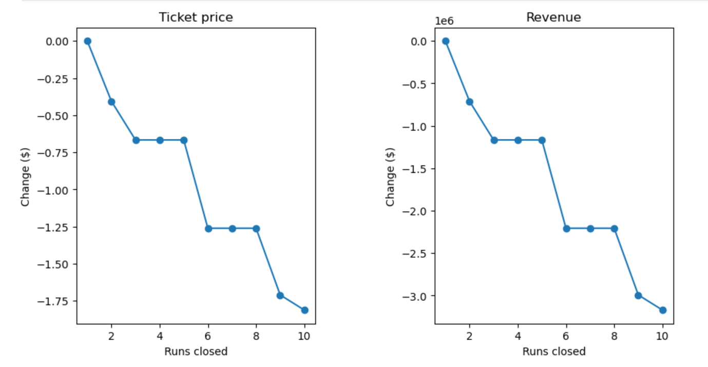
Impact of Facility Changes on Pricing
What Happens When We Make Changes?
Adding a Chair Lift:
Supports a $1.99 ticket price increase
Increases seasonal revenue by ~$3.47M
Closing Runs:
Closing up to 5 runs = No major impact.
Closing 6+ runs = Significant ticket price drop.
🔹 Carefully selecting facility changes ensures revenue growth.
revenue growth.
Notes:
Notes: "So, what happens when we make changes to our facilities? We ran scenario modeling to see the impact of different investment decisions. The results were striking—adding a chair lift supports a $1.99 increase in ticket price and boosts seasonal revenue by $3.47M. However, closing too many runs has the opposite effect—closing 6 or more runs leads to a drop in ticket price. This tells us that we need to be strategic about closures while maximizing investments in high-impact areas."
Notes: Explain how scenario modeling helps predict revenue changes. This slide should drive home why some investments are smarter than others.

Slide 5
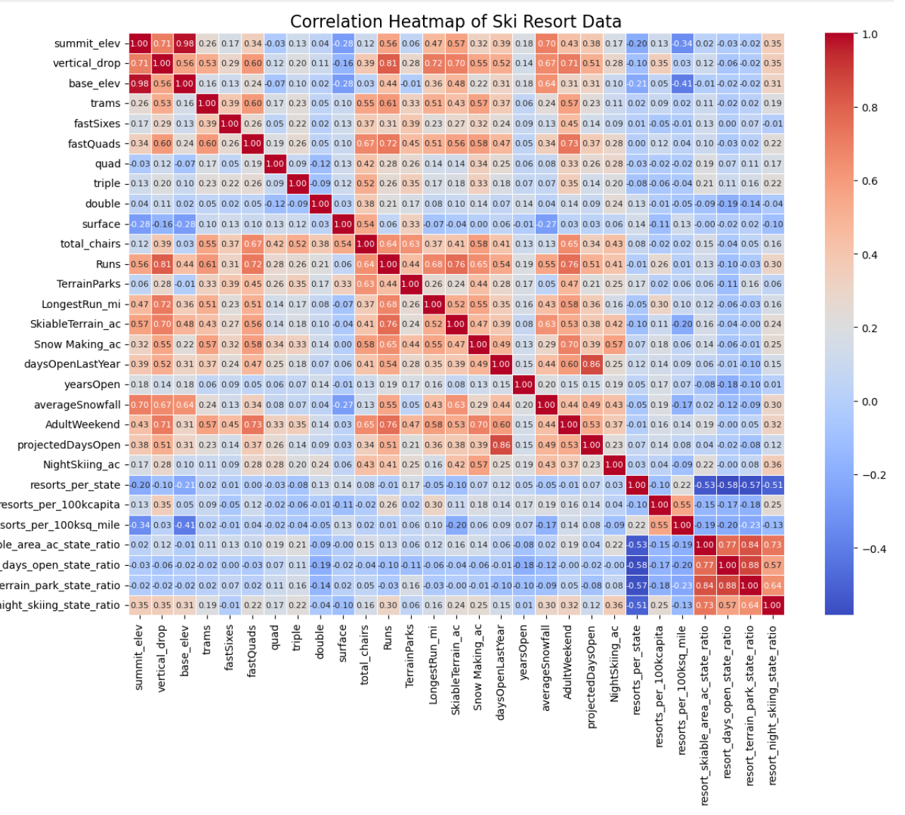
Competitive Positioning & Market
How Do We Compare?
Big Mountain’s current positioning vs. competitors.
Market supports higher ticket prices for resorts with strong features.
Key takeaway: We have room to increase pricing without hurting demand.
🔹 We can price competitively while maintaining customer value.

Slide 6
The Recommendation – A Smarter Pricing Strategy
What Should Big Mountain Do Next?
✔ Gradually increase ticket prices to $95.87 while monitoring visitor response.
✔ Invest in revenue-driving features (fast quads, runs, vertical drop).
✔ Avoid unnecessary expenses (e.g., snowmaking expansion).
🔹 This plan balances profitability and customer satisfaction.
Notes:
Notes: "So, what’s the best course of action? The data supports a clear plan: gradually increase ticket prices to $95.87 while monitoring customer response. At the same time, we should focus investments on the factors that truly impact pricing—fast quads, the number of runs, and vertical drop. Snowmaking expansion, on the other hand, does not significantly affect pricing and should not be a priority. This strategy balances profitability with customer experience and long-term competitiveness."
Notes: Use a confident tone here. The data supports gradual price increases and targeted investments. Frame this as an opportunity, not just a fix.

Slide 7
Summary & Next Steps
Key Takeaways
✔ Big Mountain is underpricing its tickets.
✔ Gradual price increases align with market expectations.
✔ Facility investments should focus on fast quads, runs, & vertical drop.
✔ Monitor competitor pricing & visitor response.
Next Steps:
Begin implementing gradual ticket price increases.
Evaluate potential investment in additional chair lifts.
Continue using data-driven decision-making for pricing strategies.
Notes:
Notes: "To wrap things up, here are the key takeaways. Big Mountain Resort is underpricing its tickets, and we have a data-backed opportunity to increase prices gradually. The market supports a higher price, and by investing in the right areas—fast quads, runs, and vertical drop—we can sustain this increase without losing customer interest. Moving forward, we should start implementing price adjustments, assess potential investments, and continue using data-driven strategies to guide our decisions. Now, let’s discuss any questions you may have."
Notes: Reinforce that this is a low-risk, high-reward strategy. Conclude with a strong call to action, making it clear that the next steps are actionable and data-driven.

Slide 8
Thank You! Questions?
🚀 Let’s make Big Mountain the top choice for skiers while maximizing profitability!

